Slide 1
PSCS_76_E-Waste Facility Locator
CSE7101- Capstone Project
Final Review
Batch Number: CSE_224
Under the Supervision of,
Dr. N Thrimoorthy
Assistant Professor
School of Computer Science and Engineering
Presidency University
Roll Number | Student Name
20221CSE0626 | THEJAS C
20221CSE0624 | T M TEJASHWINI
20221CSE0628 | VINAY K HIREMATH
Name of the Program: CSE7101 - Capstone Project
Name of the HoD: Dr. Blessed Prince
Name of the Program Project Coordinator: Mr.Muthuraju V
Name of the School Project Coordinators: Dr. Sampath A K , Dr. Geetha A

Slide 2
Content
Abstract
Literature survey
Objectives
Existing Methods and Drawbacks
Proposed Method & Feasibility Study
Architecture Diagram
Modules
Software Details
Time line
Project Output
GitHub link
References

Slide 3
Abstract
This project tackles the growing issue of electronic waste by promoting responsible disposal. It offers a web-based platform that helps users locate nearby recycling centers, learn about e-waste hazards, and earn credit points for submitting device details, encouraging repeat engagement and eco-friendly behavior.

Slide 4
Literature survey (paper 1)
e-WASTE: Everything an ICT Scientist and Developer Should Know
A. Pont, A. Robles, and J. A. Gil, “e-WASTE: Everything an ICT Scientist and Developer Should Know,” IEEE Access, vol. 7, 2019.
Review:
Explains global e-waste scale, toxic components, and hazards.
Covers recycling methods and their limitations.
Notes regulatory gaps and circular economy needs.
Analysis:
Highlights the urgent need for awareness and accessible disposal points, directly relevant to our locator app.
Emphasizes lack of recycling infrastructure, which our project can address by mapping facilities.
Our project can bridge knowledge–action gap

Slide 5
Literature survey (paper 2)
Blockchain-Based IoT-Enabled E-Waste Tracking
A. U. R. Khan and R. W. Ahmad, “A Blockchain-Based IoT-Enabled E-Waste Tracking and Tracing System for Smart Cities,” IEEE Access, vol. 10, 2022.
Review:
Proposes blockchain + IoT system for e-waste tracking in smart cities.
Uses Ethereum smart contracts, smart bins, and IPFS storage.
Ensures transparency, reputation-based stakeholder selection, and certified data destruction.
Analysis:
Highlights trust, traceability, and fraud prevention in e-waste handling.
Suggests how rewards and verified facility data can be added to our project.
Our locator can adopt lighter versions of blockchain-based incentives.

Slide 6
Literature survey (paper 3)
E-Waste Management Challenges in India (PRO Perspective)
T. S. Gaur, V. Yadav, S. Mittal, S. Singh, and M. A. Khan, “E-Waste Management Challenges in India From the Perspective of Producer Responsibility Organizations,” IEEE Access, vol. 13, 2025.
Review:
Identifies 9 major challenges for PROs in India (collection, recycling, disposal).
DEMATEL used to rank issues like poor collaboration, lack of tech, and high costs.
Recommends knowledge-sharing, advanced recycling, and policy support.
Analysis:
Shows need for facility tracking and transparency — aligns with our locator’s goal.
Highlights lack of awareness and infrastructure, which our project addresses by mapping centers.
Suggests adding features for knowledge sharing and consumer engagement to improve impact.

Slide 7
Literature survey (paper 4)
Extended TOPSIS Method for Recycling Partner Selection
A. Qadir, S. Abdullah, S. Khan, and F. Khan, “A New Extended Topsis Method for E-Waste Recycling Partner Selection Under Complex Pythagorean Fuzzy Rough Dombi Aggregation Operator,” IEEE Access, vol. 12, 2024.
Review:
Proposes a new method to choose the best recycling partners.
Handles uncertainty in data using advanced math models.
Tested on real e-waste recycling case for validation.
Analysis:
Useful for ranking and selecting the right facilities/partners.
Our locator can use simpler ranking to guide users to the best centers.

Slide 8
Literature survey (paper 5)
Blockchain for Waste Management in Smart Cities
R. W. Ahmad, K. Salah, R. Jayaraman, I. Yaqoob and M. Omar, “Blockchain for Waste Management in Smart Cities: A Survey,” IEEE Access, vol. 9, 2021.
Review:
Surveys blockchain use in waste management systems.
Highlights benefits: transparency, security, and fraud prevention.
Discusses challenges like scalability, cost, and integration with IoT.
Analysis:
Supports our project with ideas on secure and trusted facility data.
Suggests how rewards/credits can be made tamper-proof.
Helps plan future expansion of our locator with blockchain features.

Slide 9
Literature survey (paper 6)
Electronic Waste Reduction Through Circular Design
M. Chakraborty, J. Kettle, and R. Dahiya, “Electronic Waste Reduction Through Devices and Printed Circuit Boards Designed for Circularity,” IEEE Access, vol. 12, 2024.
Review:
Focuses on designing devices and PCBs for reuse, repair, and recycling.
Promotes circular economy to reduce e-waste at the design stage.
Case studies show benefits in material recovery and reduced disposal.
Analysis:
Stresses long-term solution: design for sustainability.
Our locator complements this by guiding users for proper disposal.
Together, design + disposal awareness can cut e-waste impact.

Slide 10
Literature survey (paper 7)
E-Waste Management: Are We Ready for It?
L. F. Chen and H. W. Yee, “E-waste management: Are we ready for it?: A study on the awareness of COIT students toward e-waste management,” IEEE, 2011.
Review:
Surveyed Malaysian COIT students’ awareness of e-waste issues.
Found low readiness and lack of knowledge on proper management.
Main reason: no Green IT or e-waste subjects in curriculum.
Analysis:
Highlights major gap in awareness and education.
Our locator can fill this gap with awareness features and guidance.

Slide 11
Literature survey (paper 8)
E-Sangrahan: Framework for Efficient E-Waste Management
N. S. Malagati, M. Rajesh, and B. Sreevidya, “E-Sangrahan: A Sustainable Paradigm and Comprehensive Framework for Efficient E-Waste Management Towards a Greener Future,” IEEE, 2019.
Review:
Proposes a web-based platform “E-Sangrahan” for e-waste management in India.
Features warehouse locator with directions for disposal.
classify e-waste vs non-e-waste items.
Analysis:
Very close to our locator concept, validates our approach.
ML-based identification can enhance user awareness in our system.
Shows potential of web platforms in bridging awareness and action.

Slide 12
Literature survey (paper 9)
SAFA-E: The E-Waste Management System
V. Chaturvedi, R. Babbar, I. Arora, D. Varshney, and U. Hariharan, “SAFA-E (The E-Waste Management System),” IEEE, 2021.
Review:
Proposes SAFA-E, an Android + web system for e-waste management.
Collects user data on household e-waste and provides proper disposal/recycling options.
Targets pollution issues from toxic materials like Pb, Cd, and Hg in devices.
Analysis:
Very close to our locator project, offering both awareness and disposal guidance.
Confirms feasibility of mobile/web platforms for user–facility connection.
Suggests adding household-level data collection in our system for impact.

Slide 13
Literature survey (paper 10)
Design & Development of E-Waste Monitoring, Segregation and Recycling System
M. S. Roy, M. N. I. Lusan, M. A. R. Khan, M. P. Khan, A. Ahmed, and M. S. R. Zishan, “Design and Development of E-Waste Monitoring, Segregation and Recycling System,” IEEE, 2021.
Review:
Proposes automated detection, sorting, and segregation of e-waste.
Uses conveyor + shredding to recover reusable materials.
Includes website for digital collection and monitoring of e-waste.
Analysis:
Highlights automation as a key to efficient recycling.
Our locator can integrate digital collection/monitoring aspects.
Shows value of linking physical recycling tech with online platforms.

Slide 14
Objectives
Develop a platform for users to easily locate e-waste facilities.
Educate on harmful effects of improper disposal.
Introduce incentive-based participation (credit points).
Promote sustainable recycling practices.

Slide 15
Existing Methods and Drawbacks
Existing methods:
Simple locators for recycling facilities.
Government awareness programs.
Drawbacks:
No recoverable metal estimation..
Minimal user education on e-waste hazards.
Lack of incentives.

Slide 16
Proposed Method & Feasibility Study
Proposed method:
Web platform with location-based services.
Awareness on e-waste hazards.
Incentive system for responsible recycling.
Feasibility:
Uses existing web and mapping technologies.
Low hardware cost.
Scalable and sustainable model.

Slide 17
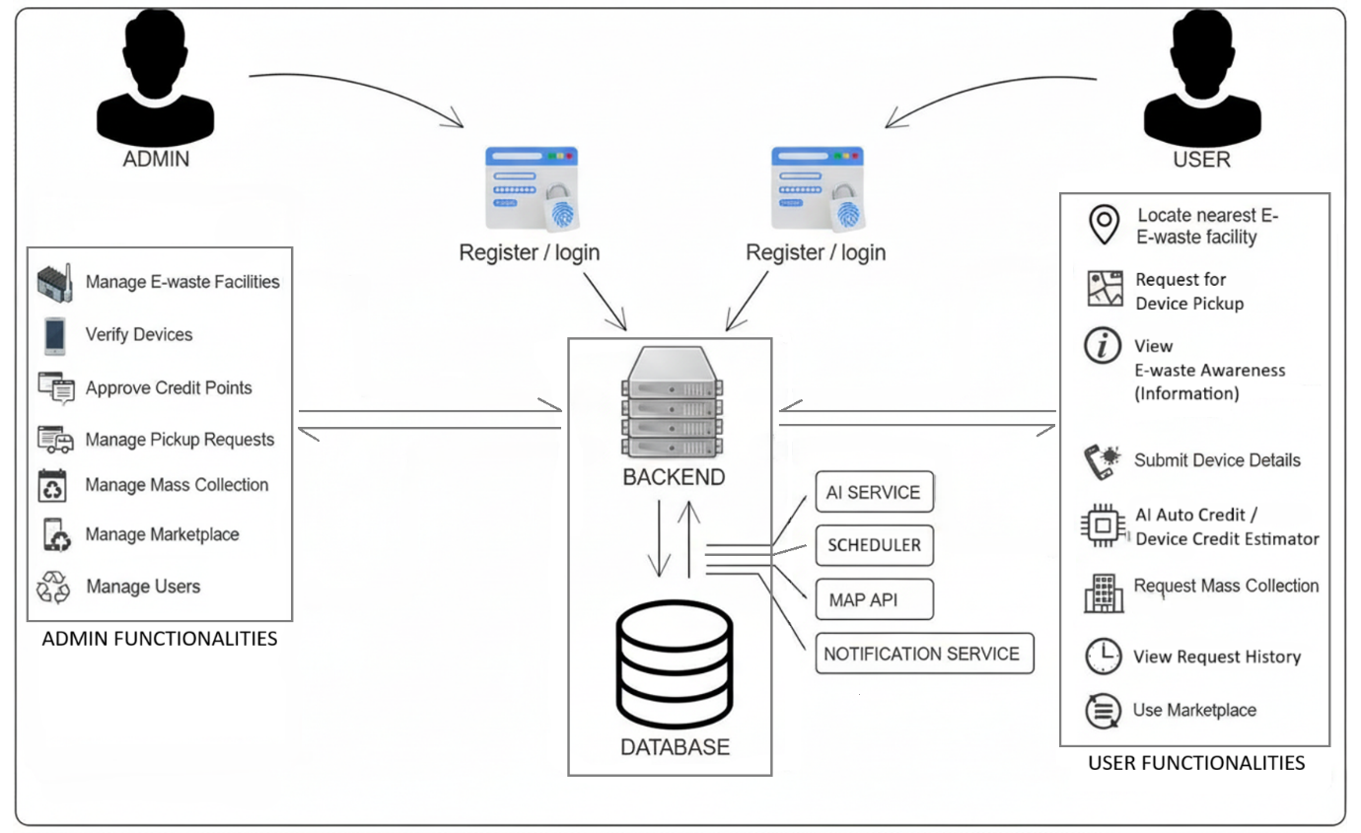
Architecture Diagram

Slide 18
Modules
User Module
  Facility Locator: Find nearest e-waste recycling points.
  Educational Resources: Learn about e-waste hazards and disposal benefits.
  Credit Point System: Earn rewards for responsible disposal.
Admin Module
  Facility Management: Add or update e-waste recycling centres.
  Device Verification: Authenticate submitted devices for disposal.
  Credit Approval: Review and approve user-earned points.

Slide 19
Modules (cont.)
Backend Module
  API Integration: Facilitates communication between frontend and database.
  Authentication & Validation: Manage secure sessions and input checks.
  Data Management: Store and retrieve user profiles, facility data, and logs.

Slide 20
Software Details
Layer | Technology
Frontend | HTML5, CSS, Leaflet
Backend | Node.js + express.js
Database | MySQL
Deployment (optional) | AWS

Slide 21
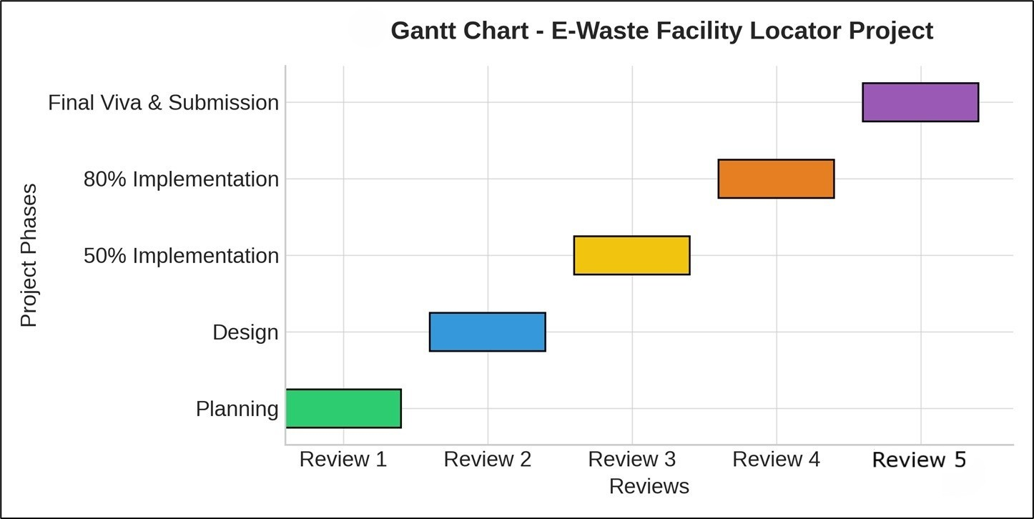
Timeline of the Project (Gantt Chart)

Slide 22
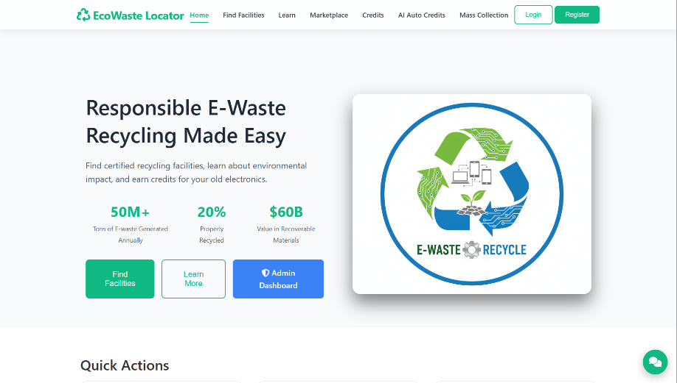
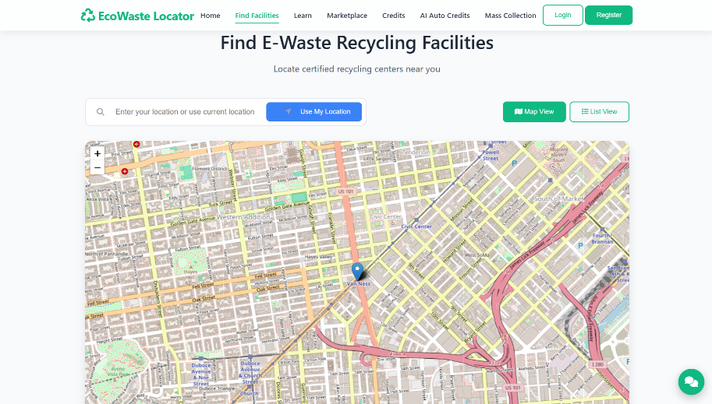
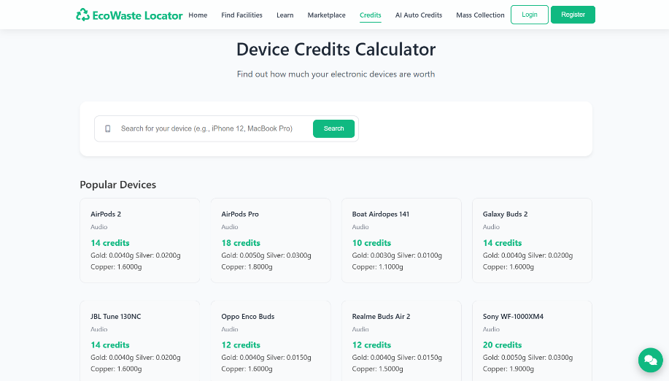
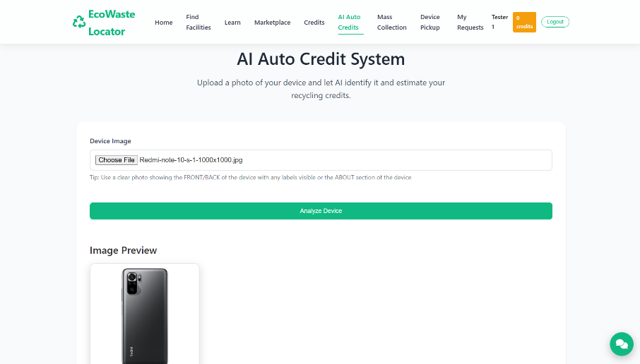
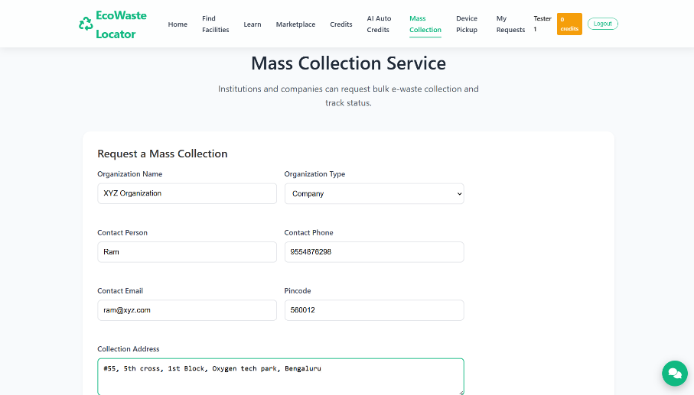
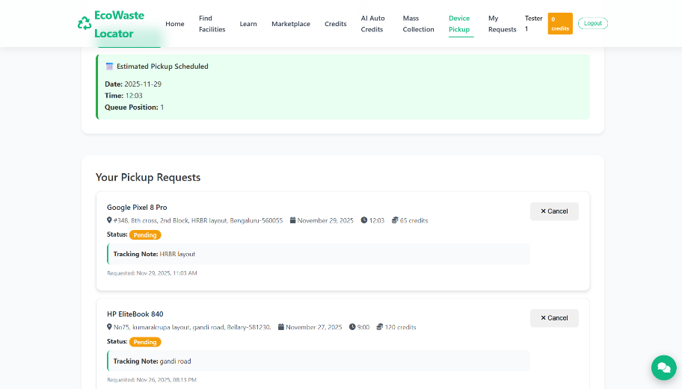
Project Output

Slide 23
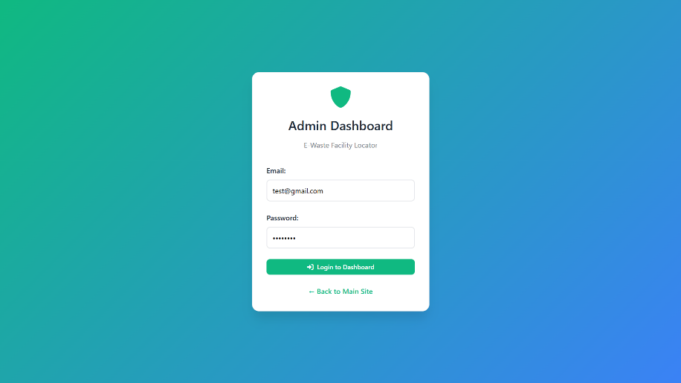
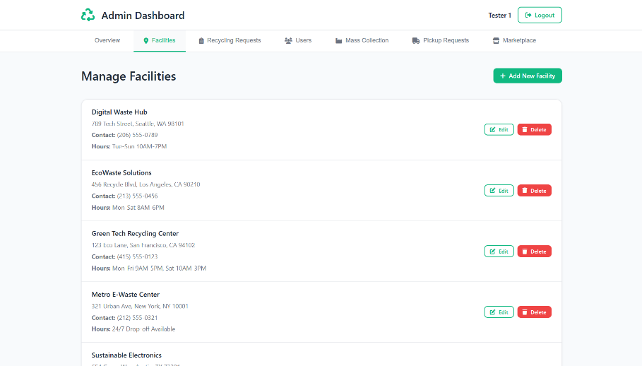
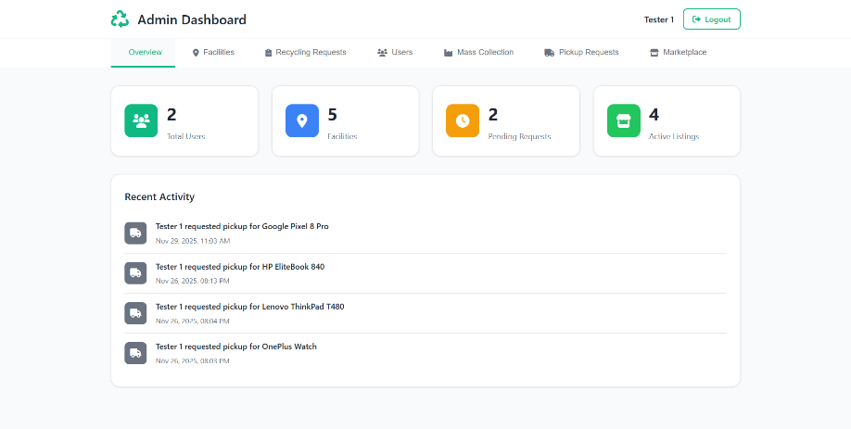
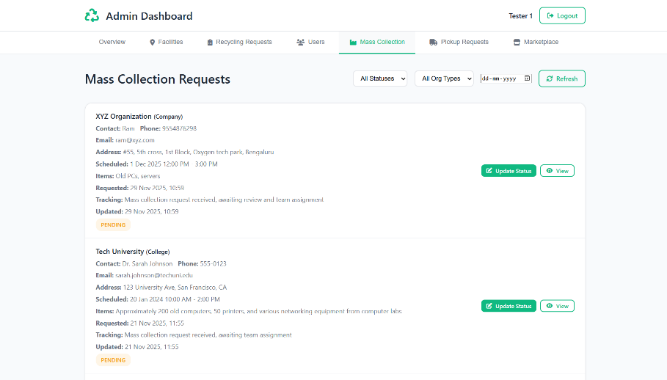
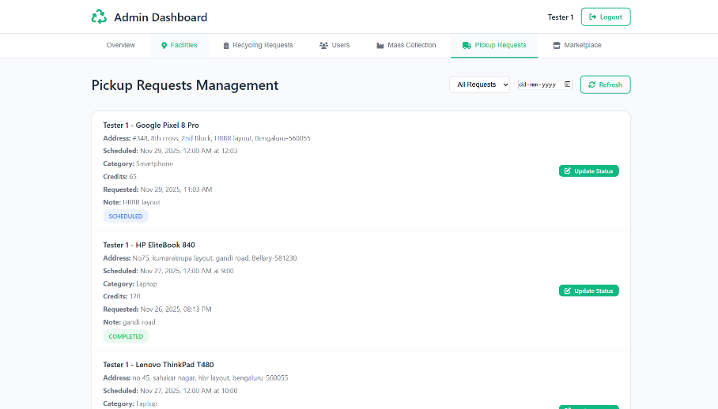
Project Output (contd.)

Slide 24
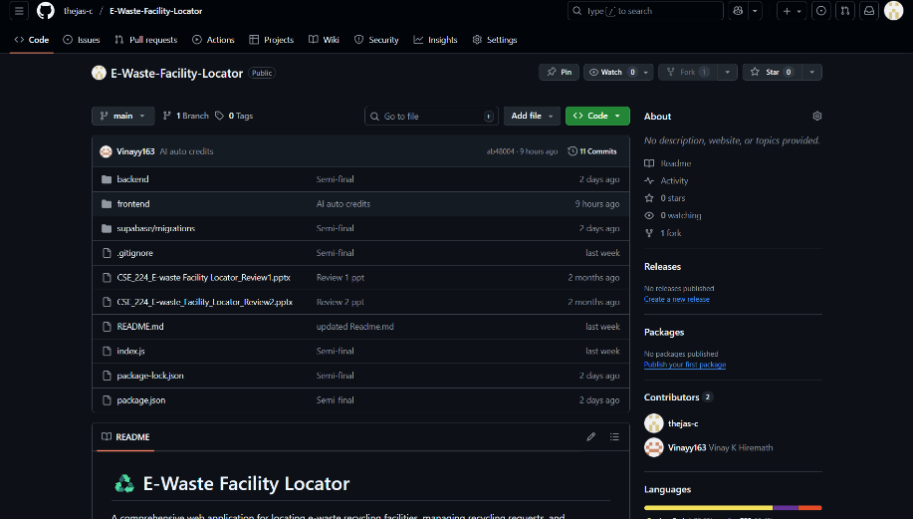
GitHub Link
https://github.com/thejas-c/E-Waste-Facility-Locator

Slide 25


